Slide 2
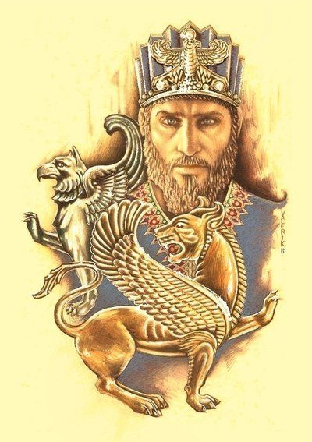
Greater than Cyrus

Slide 3
What preceded & precipitated the fall of Jerusalem and dispersion to Babylon, yet with hope and promise
Who was Cyrus and forces that would conquer Babylon
Prophetic events for dating the fall of Babylon linking Bible & secular chronology
Cyrus decree important for Israel and the Greater than Cyrus now

Slide 4
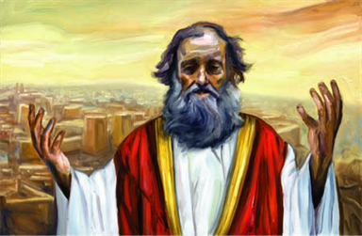
Jer. 50:5-8 “They shall ask the way to Zion with their faces thither-ward, saying, Come, and let us join ourselves to the LORD in a perpetual covenant that shall not be forgotten. My people hath been lost sheep: their shepherds have caused them to go astray, they have turned them away on the mountains: they have gone from mountain to hill, they have forgotten their resting place. … Remove out of the midst of Babylon, and go forth out of the land of the Chaldeans, and be as the he goats before the flocks.”

Slide 5
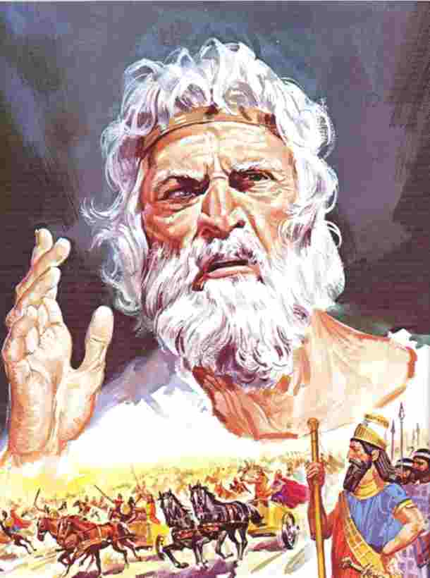
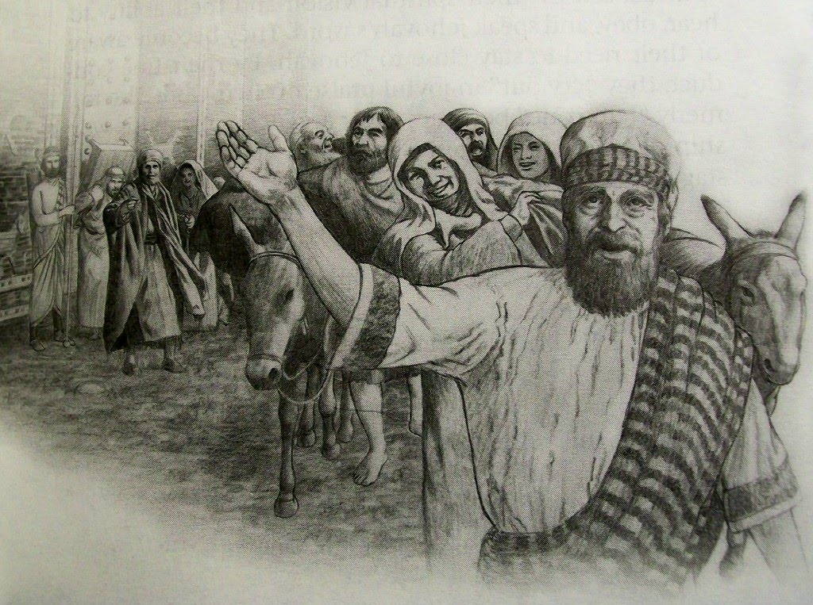
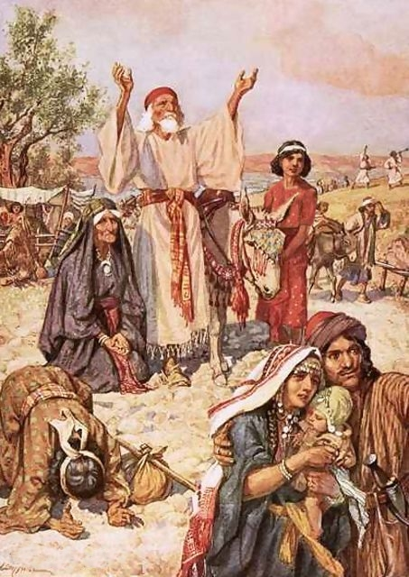

Slide 6
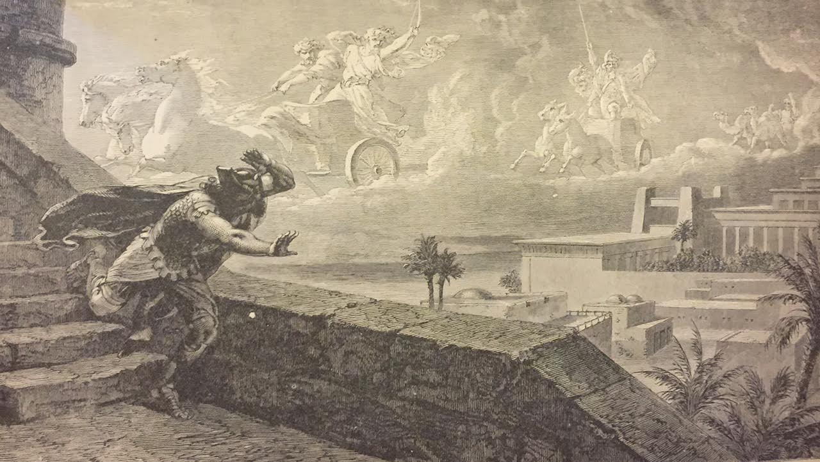
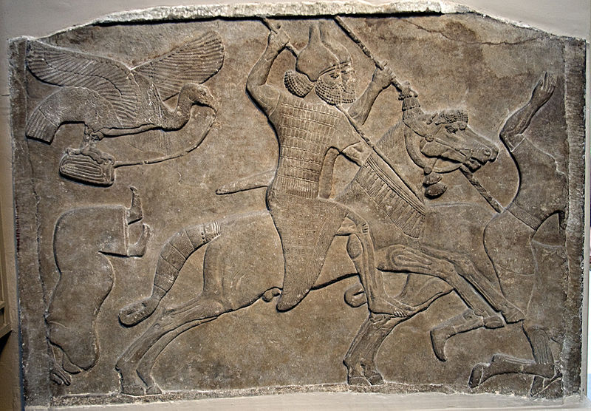
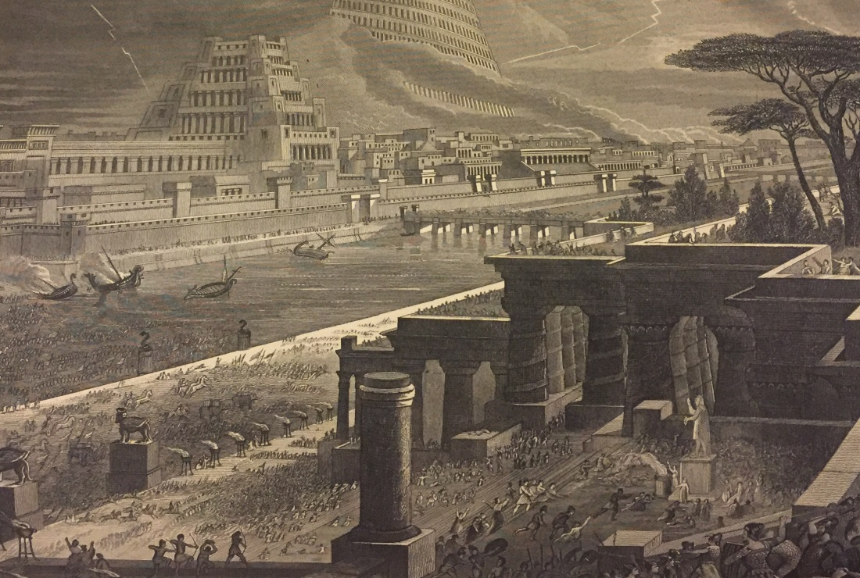
Isaiah 13

Slide 7
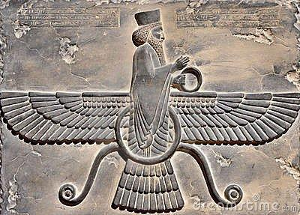
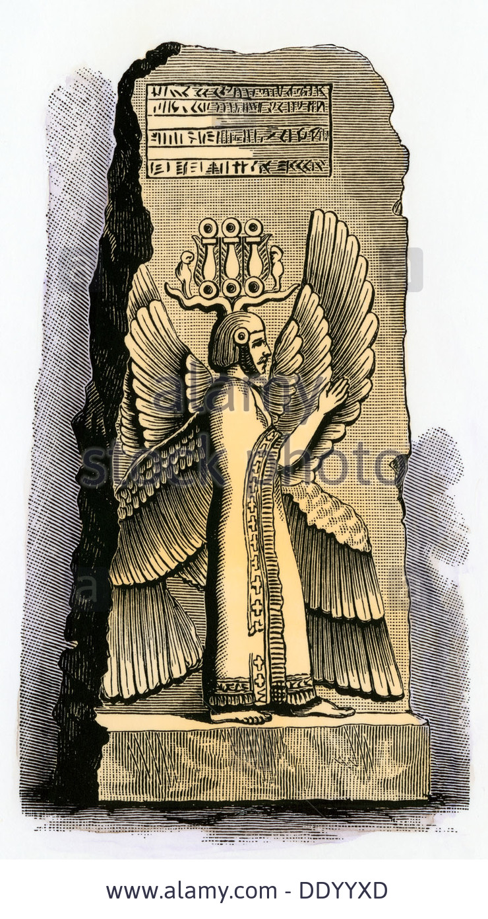
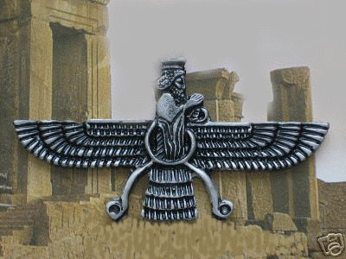
Isaiah 45:1-4
Born 580 BC
Persian King 559 – 529 BC

Slide 8
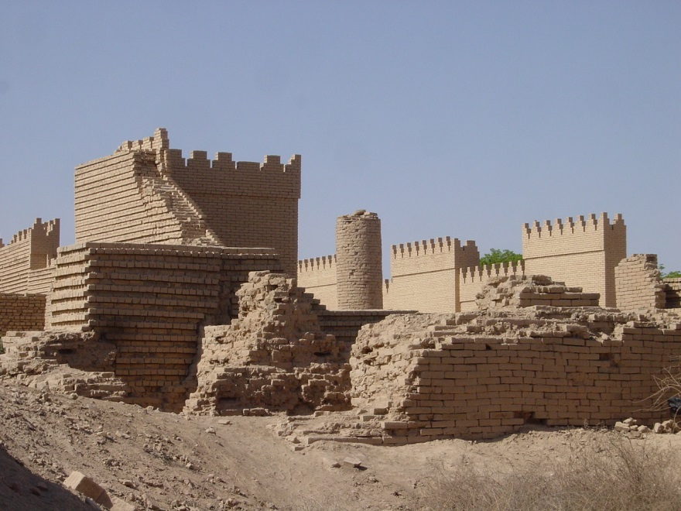

Slide 9
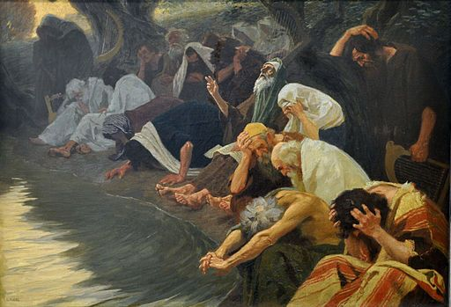
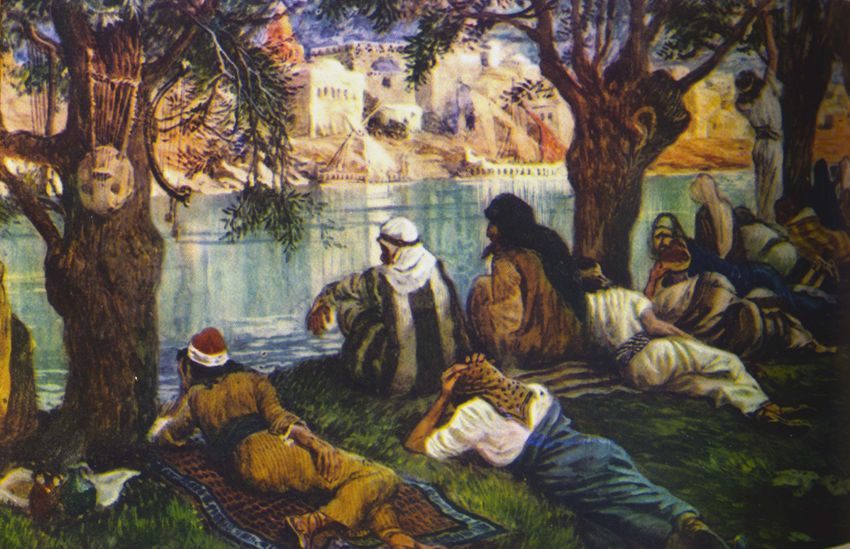
Psalm 137
By the rivers of Babylon, there we sat down,
yea, we wept, when we remembered Zion.
We hanged our harps upon the willows in the midst thereof.
How shall we sing the LORD’S song in a strange land?

Slide 10
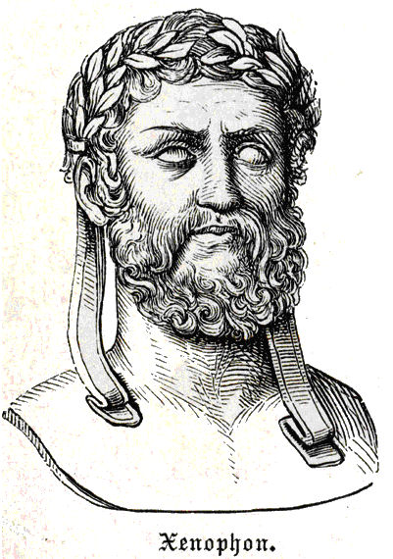
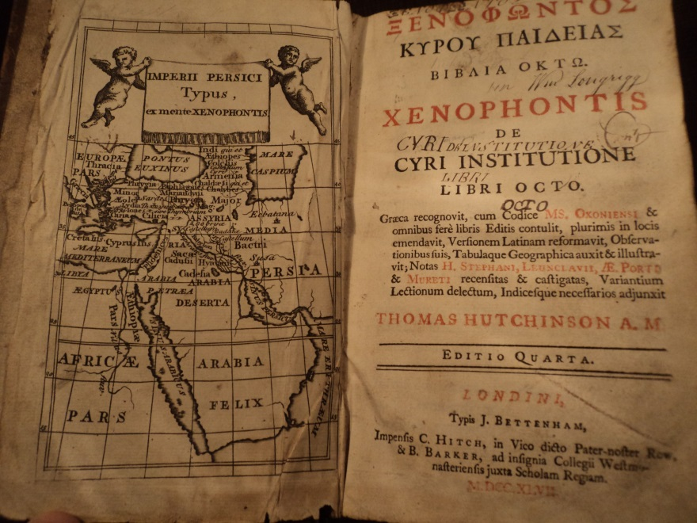
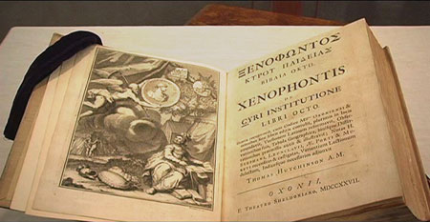
430 – 354 BC
484 - 425 BC

Slide 11
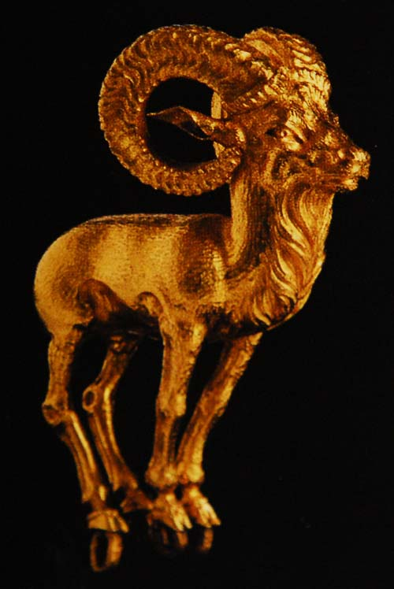
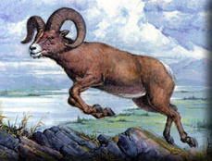
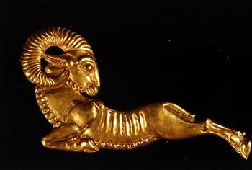
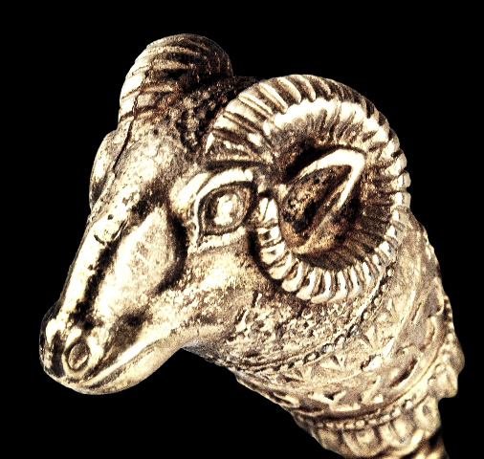
Daniel 8:3 Then I lifted up mine eyes,
and saw, and, behold, there stood before the river a ram which had two horns: and the two horns were high; but one was higher than the other,
and the higher
came up last.

Slide 12
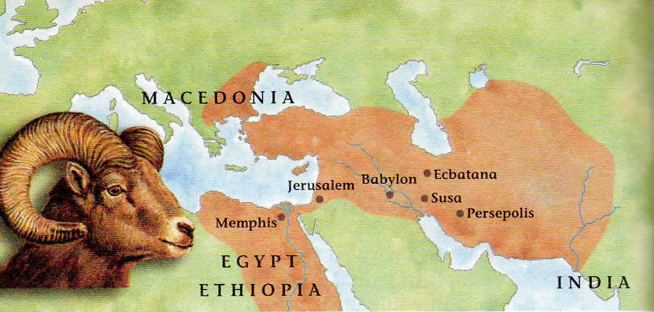
Daniel 8:4 I saw the ram pushing westward, and northward, and southward; so that no beasts might stand before him

Slide 13
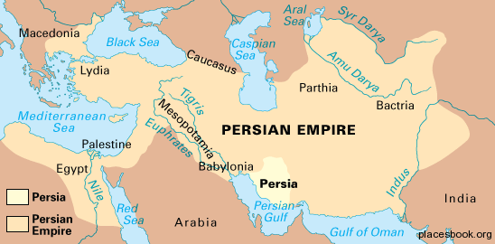
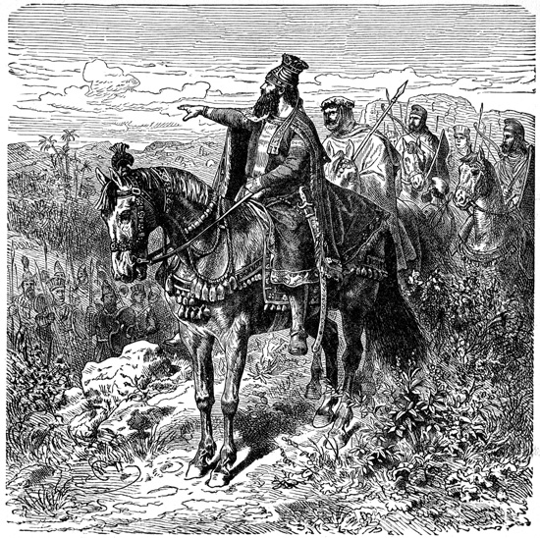
540 BC
Then the Carians fell into strife and civil war with one another; they were entrenched in strongholds, and both sides called upon Cyrus for assistance. So while Cyrus himself stayed in Sardis to make siege-engines and battering rams to demolish the walls of such as should refuse to submit...
On the way to Babylon he subdued Greater Phrygia and Cappadocia and reduced the Arabians to submission. From all these he secured armor for not less than forty thousand Persian horsemen, and many horses taken from the prisoners he distributed among all the divisions of his allies. And thus he arrived before Babylon with a great host of cavalry, and a great host of bowmen and spearmen, and a multitude of slingers that was beyond number.
Cyrus, leaving behind a large garrison of foot-soldiers, started from Sardis in company with Croesus; and he took with him many wagons loaded with valuables of every sort. And Croesus also had come with an accurate inventory of what was in each wagon; and as he handed the lists to Cyrus he said: “From this, Cyrus, you may know who renders to you in full that of which he has charge and who does not.”

Slide 14
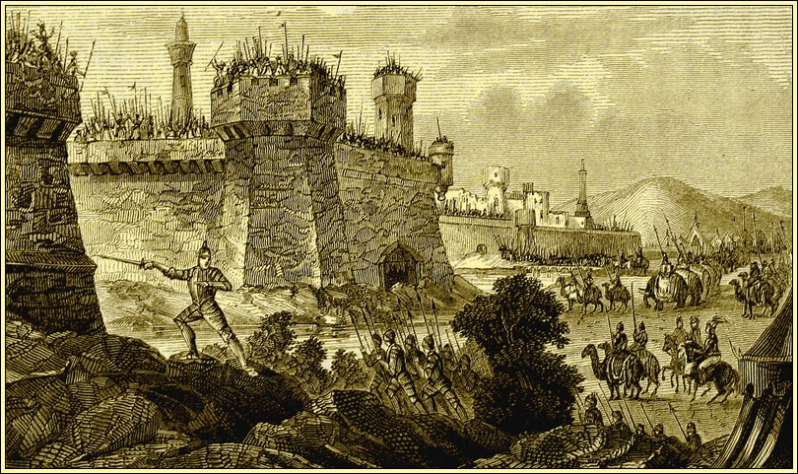
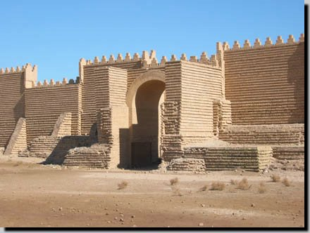
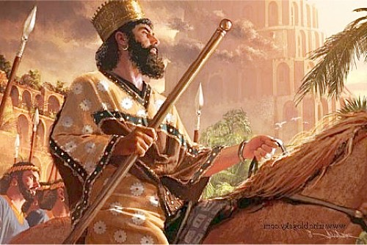
539 BC

Slide 15
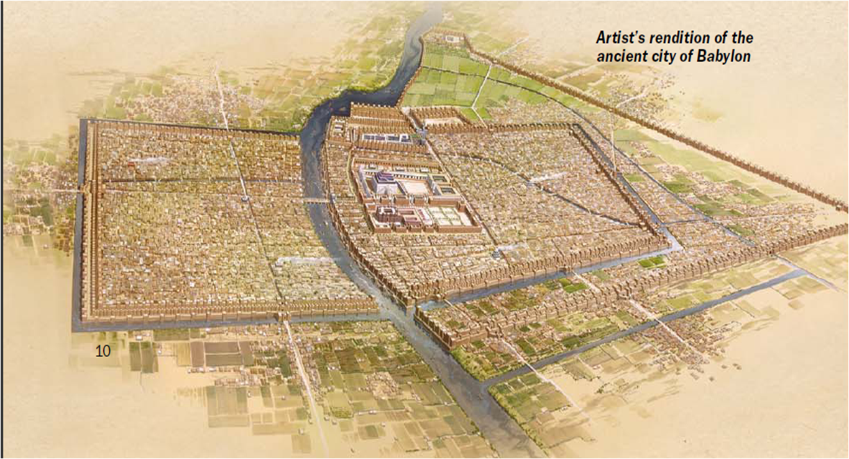

Slide 16
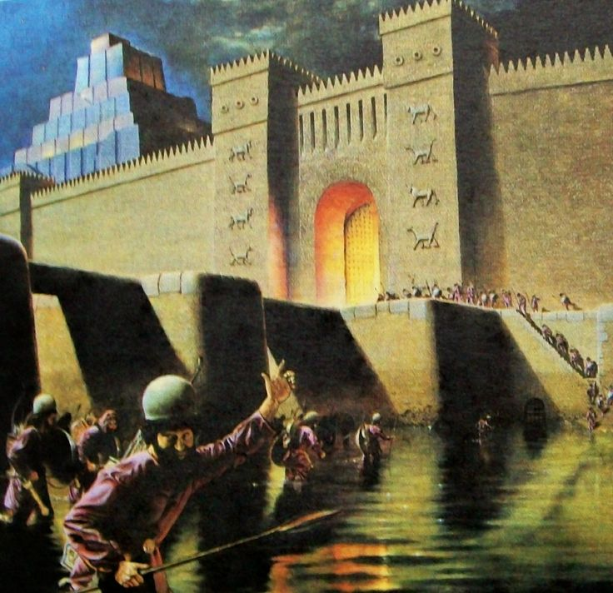
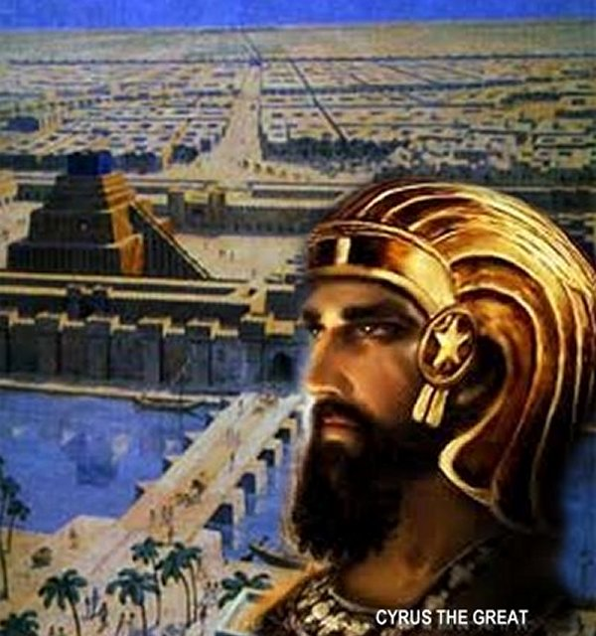
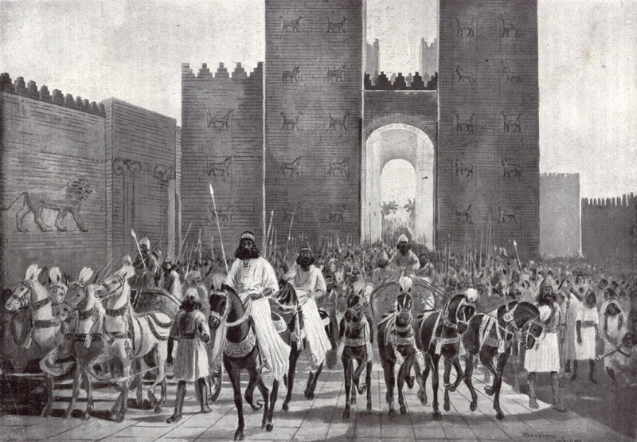

Slide 17
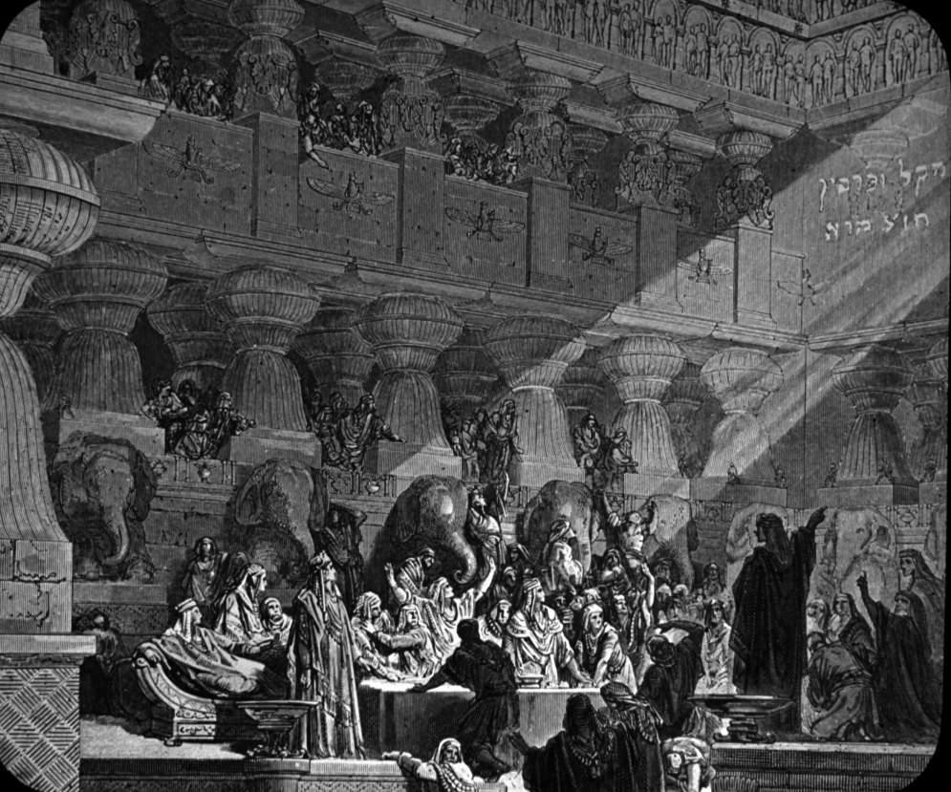
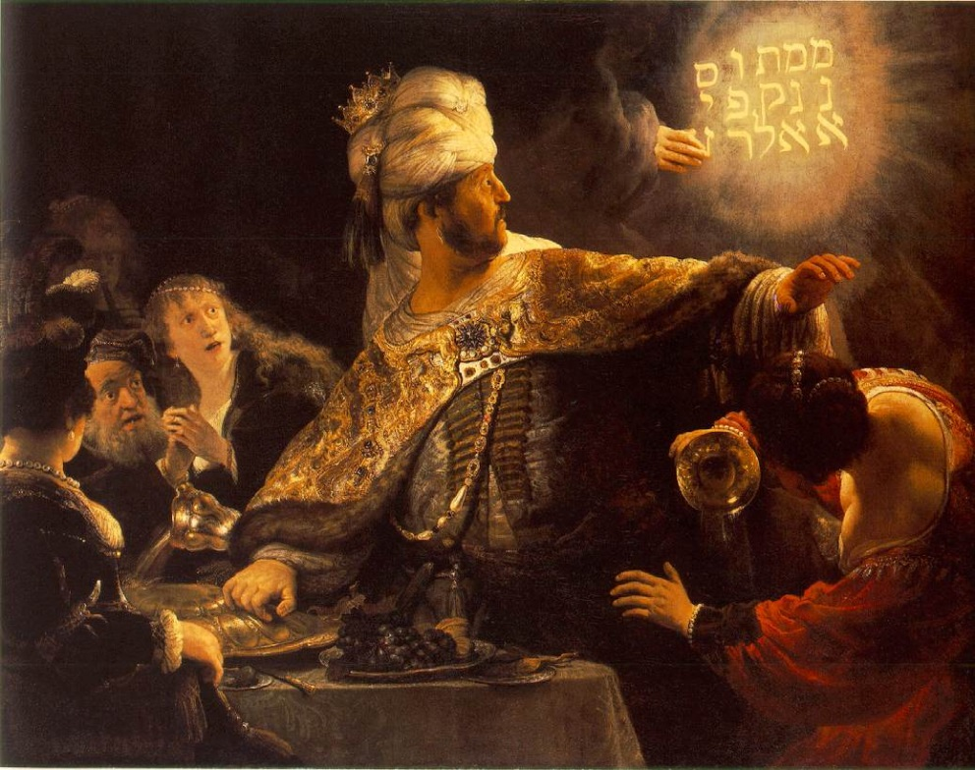
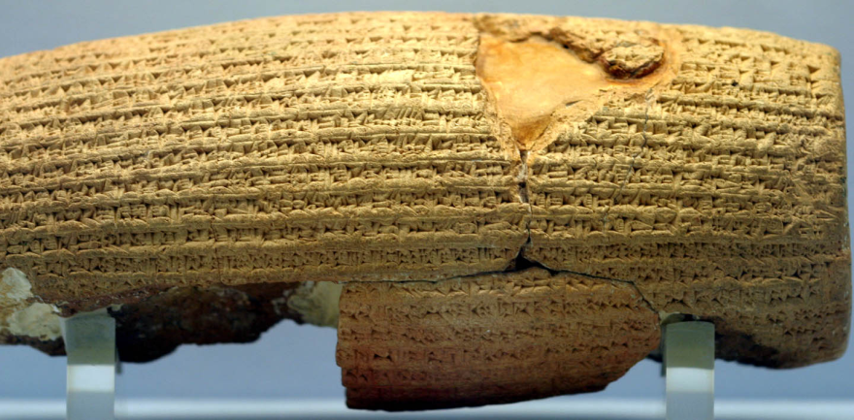
MENE MENE
TEKEL
UPHARSIN
מנא מנא תקל
ופרסין

Slide 18
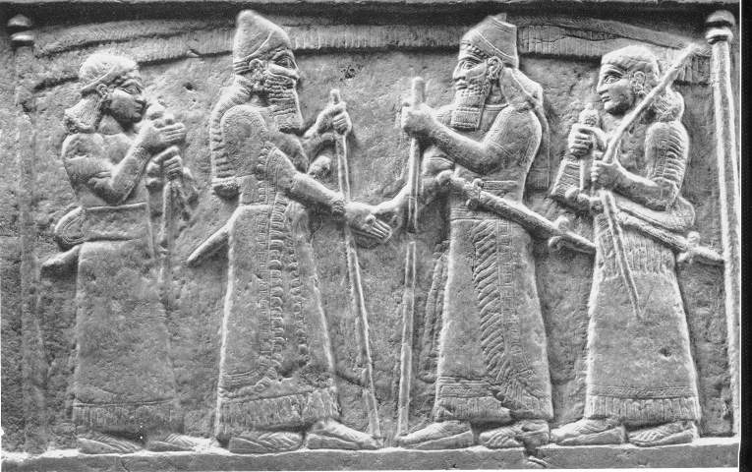
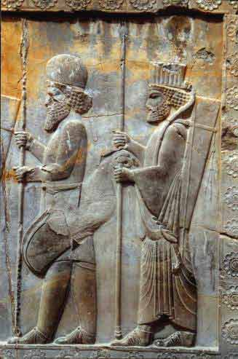
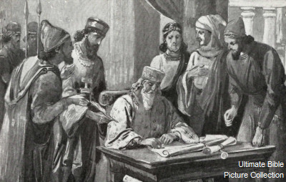
Medes & Persians
5:31 Darius the Median
received the kingdom

Slide 19
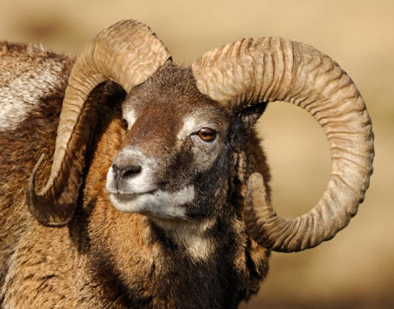
Dan. 8:3
the two horns were high; but one was higher than the other, and the higher came up last.
Dan. 6:28
So this Daniel prospered in the reign of Darius, AND in the reign of Cyrus the Persian.
Dan 9:1-2 In the first year of Darius the son of Ahasuerus, of the seed of the Medes, which was made [inducted/appointed] king over the realm of the Chaldeans;
In the first year of his reign I Daniel understood by books the number of the years, whereof the word of the LORD came to Jeremiah the prophet, that he would accomplish seventy years in the desolations of Jerusalem.

Slide 20
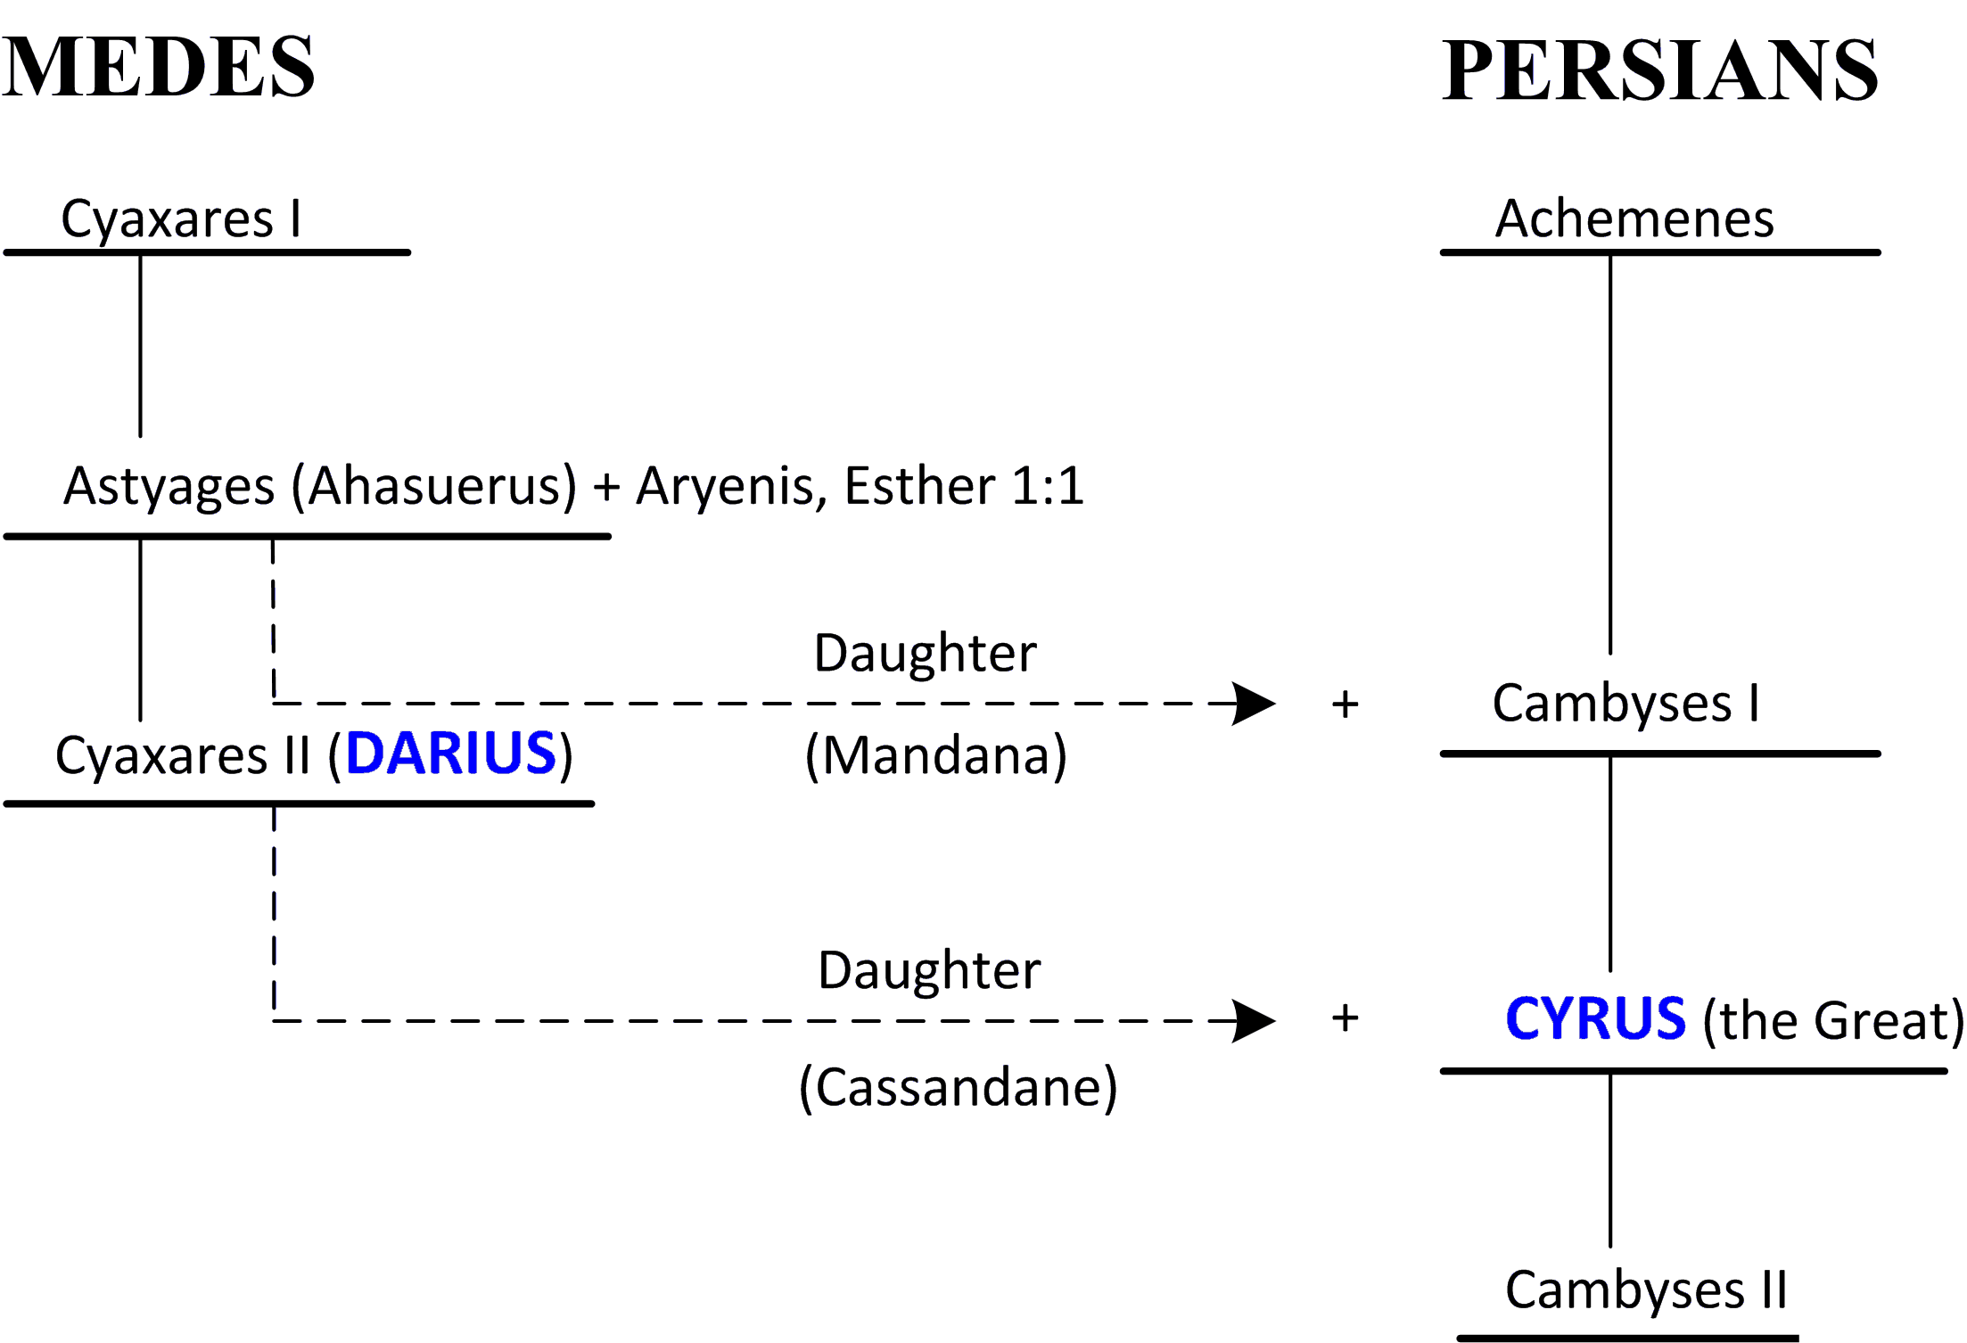

Slide 21
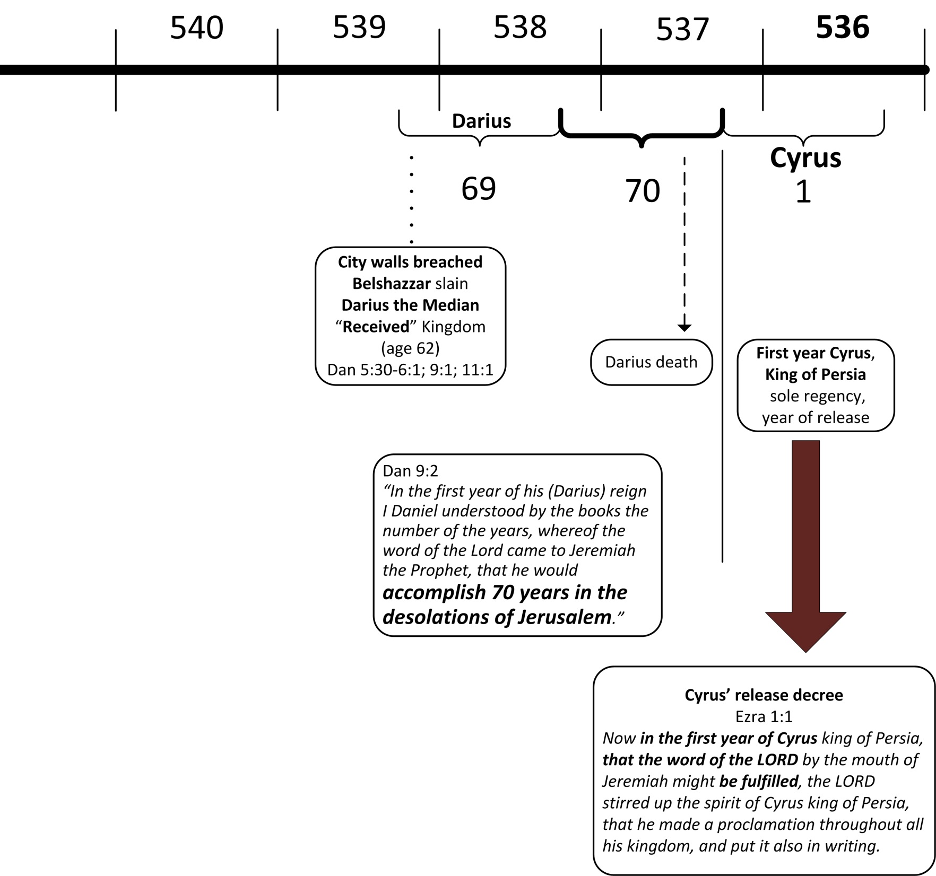
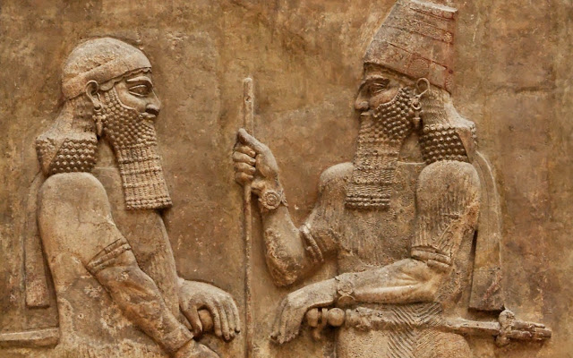
Medes
Persians
`

Slide 23
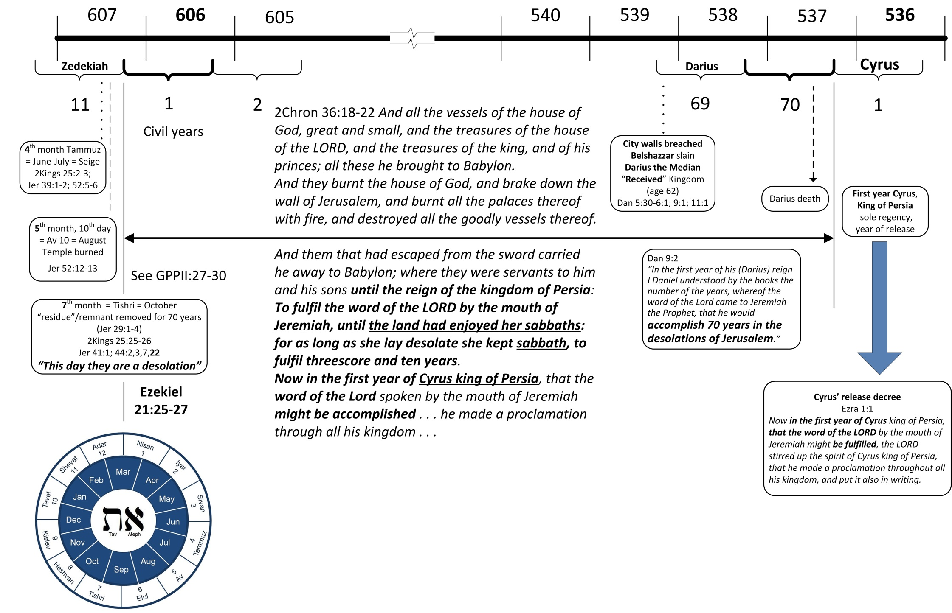

Slide 24
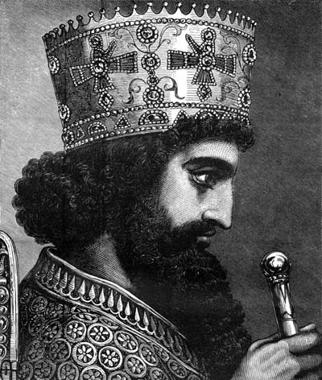
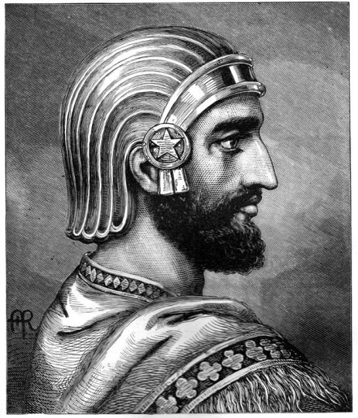
2 Peter 3:4 Where is the promise of his parousia?
3:8 Beloved, be not ignorant of this ONE thing, that ONE day is with the Lord as a thousand years, and a thousand years as ONE day
Babylon the Great is fallen . . .
Rev. 16:12
Rev. 11:15-18

Slide 27
